Slide 1
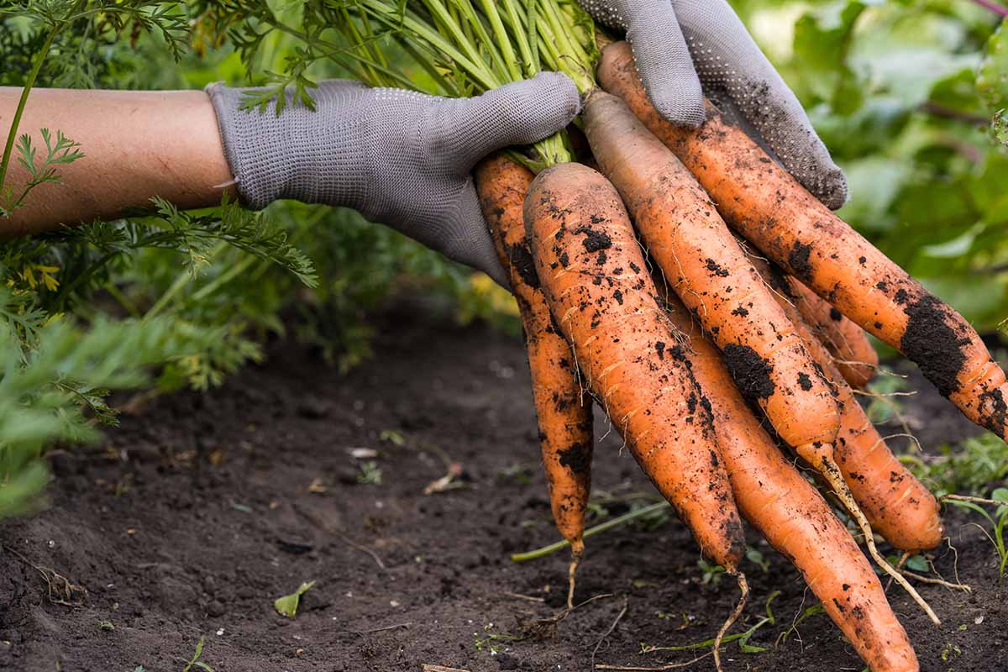
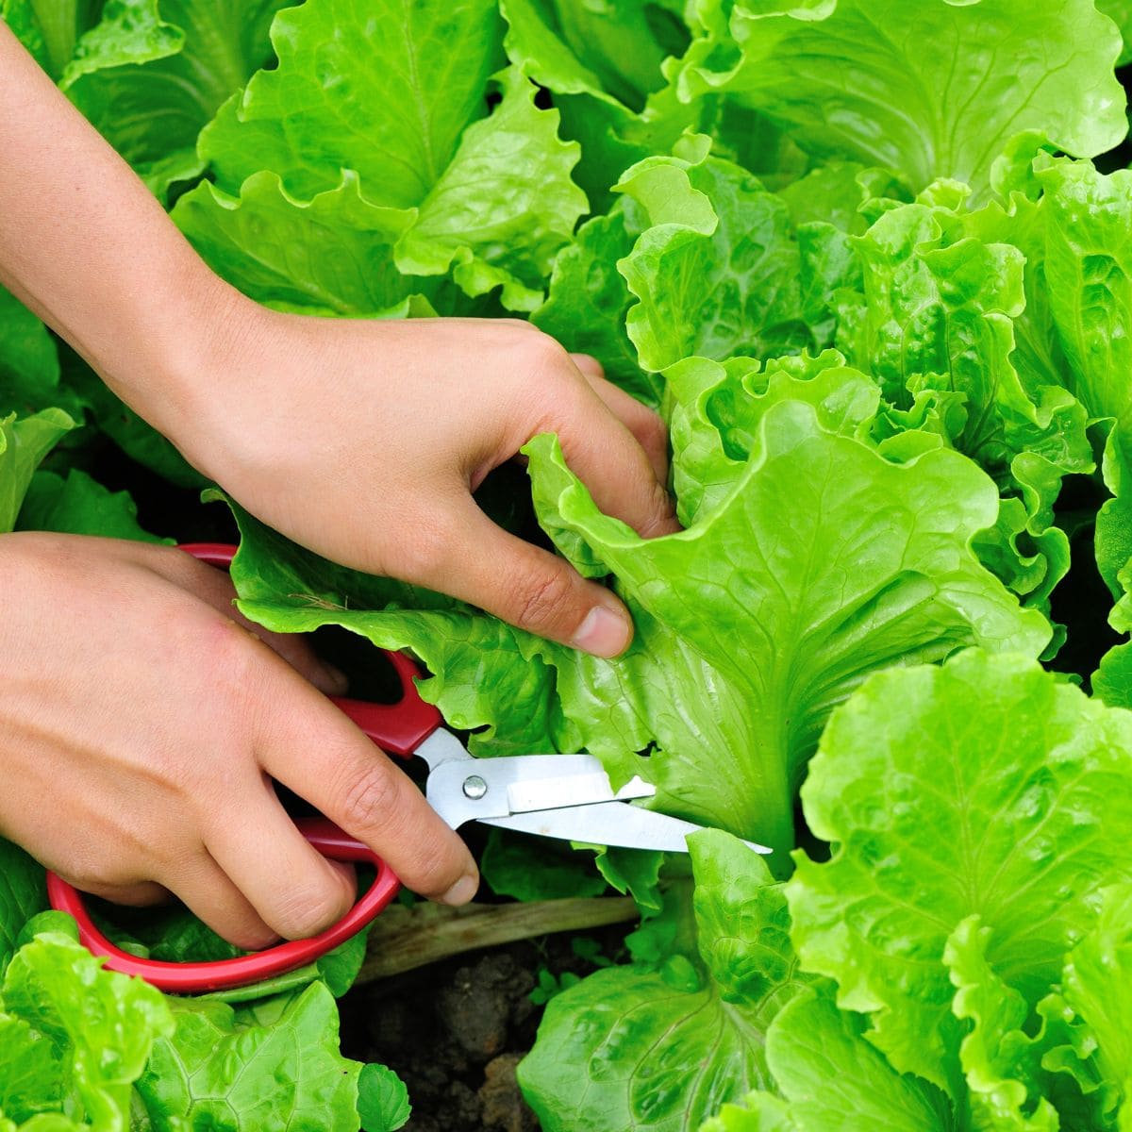

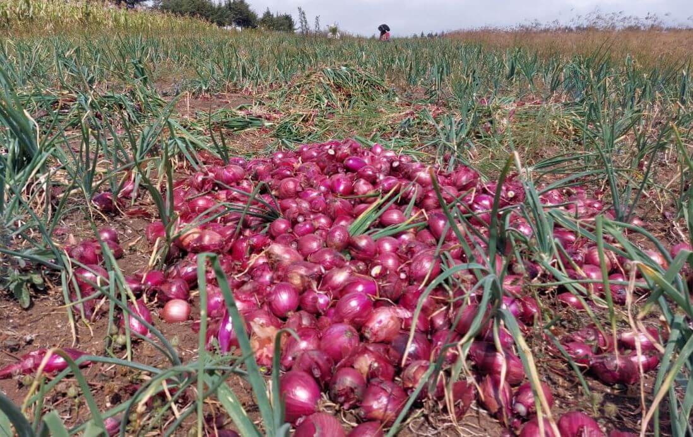
What crops should be grown on a sustainable farm?

Slide 2

The table below compares the three crops based on economic value, cultivation area, labor requirements, mechanization suitability, and storage potential to help select the most appropriate crop for sustainable farming
Crops | Economic value | Labor requirements | Storage times
Onions | high | Medium | Long
Carrots | Medium | Medium | Medium
Lettuce | Medium | Medium | Short
Based on the comparison in the table, onion was selected as the most suitable crop for sustainable farming.

Slide 3
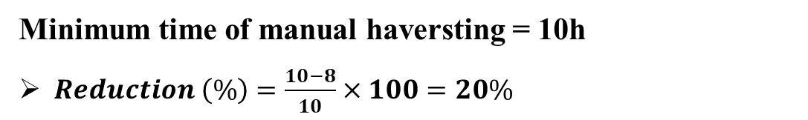

Demonstration of the performance of mechanical harvesting over manual methods
Manual harvesting: 10 - 20 hours per hectare, including digging, field drying, leaf cutting, and bulb collection.
Mechanical harvesting: Animal-drawn harvester can cover 0.5–1.3 hectares in 8 hours.
$$Reduction \left(\%\right)=\frac{Manual time −mechanical time}{Manual time}×100$$
Minimum time of manual haversting = 10h
$Reduction \left(\%\right)=\frac{10−8}{10}×100=20\%$
Maxiimum time of manual haversting = 20h
$Reduction \left(\%\right)=\frac{20−8}{20}×100=60\%$

